Slide 1
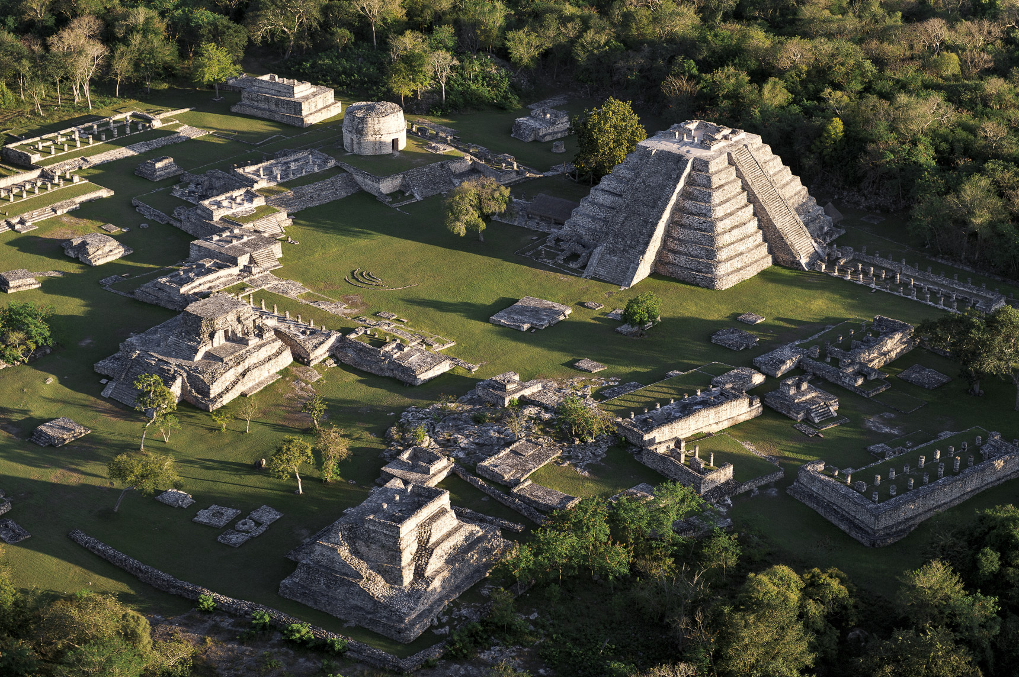
The Ancient Maya Civilization
The site you see here is just one of many Maya sites which were created in
Mesoamerica during the so-called Classic Period of their civilization.
Notes:
References:
Image source: Walled city of Mayapán, digital photograph, Yucatan, accessed March 22, 2023 <https://yucatan.travel/en/archeological-area/mayapan/>
Graham, J. (2023, March 07). Annotated Bibliography. Dropbox. https://www.dropbox.com/s/lqleovu77hsa0zd/AnnotatedBibliography.pdf?dl=0

Slide 2
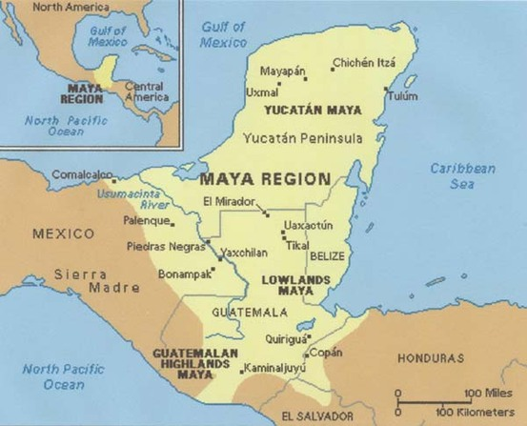
From approximately 1800 B.C. to 1050 A.D., the Maya civilization was one of Mesoamerica's most dominant indigenous societies. Located south of modern-day Mexico and north of modern-day South America, the Maya utilized both agricultural techniques and hunter-gatherer techniques and were centred around the Gulf of Mexico and the Caribbean Sea.
Notes:
References:
Image source for Mesoamerica map: Classical Mayan Period 2016, digital image, Human History In Brief, accessed March 22, 2023, <http://www.humanhistoryinbrief.net/2016/11/>
Graham, J. (2023, March 07). Annotated Bibliography. Dropbox. https://www.dropbox.com/s/lqleovu77hsa0zd/AnnotatedBibliography.pdf?dl=0

Slide 3

The Maya lived in three areas with distinct cultural and environmental differences, the first of which was The Northern Maya Lowlands. They were located primarily in the Yucatán Peninsula, near the Yucatán Maya, marked on the map in a red circle.
Notes:
References:
Image source for Mesoamerica map: Classical Mayan Period 2016, digital image, Human History In Brief, accessed March 22, 2023, <http://www.humanhistoryinbrief.net/2016/11/>
Graham, J. (2023, March 07). Annotated Bibliography. Dropbox. https://www.dropbox.com/s/lqleovu77hsa0zd/AnnotatedBibliography.pdf?dl=0

Slide 4
The next area is known as the Southern Lowlands, mainly in the Peten district of northern Guatemala and adjacent portions of Mexico, Belize and western Honduras, marked on the map in a blue circle.
Notes:
References:
Image source for Mesoamerica map: Classical Mayan Period 2016, digital image, Human History In Brief, accessed March 22, 2023, <http://www.humanhistoryinbrief.net/2016/11/>
Graham, J. (2023, March 07). Annotated Bibliography. Dropbox. https://www.dropbox.com/s/lqleovu77hsa0zd/AnnotatedBibliography.pdf?dl=0

Slide 5
The third and final area, the Southern Highlands, was in the mountainous region of southern Guatemala, seen here in the black circle.
Notes:
References:
Image source for Mesoamerica map: Classical Mayan Period 2016, digital image, Human History In Brief, accessed March 22, 2023, <http://www.humanhistoryinbrief.net/2016/11/>
Graham, J. (2023, March 07). Annotated Bibliography. Dropbox. https://www.dropbox.com/s/lqleovu77hsa0zd/AnnotatedBibliography.pdf?dl=0

Slide 6
The Maya civilization occupied Mesoamerica in the three previously-mentioned areas in 3 distinct time periods:
The Preclassic Period (1800 B.C. – 250 A.D.).
During the Preclassic Period, the Maya civilization’s citizens began establishing themselves in Mesoamerica as a hybrid agricultural hunter-gatherer society. Additionally, the construction of cities, sites, and architectural works such as the Mayan pyramids began.
Notes:
References:
Graham, J. (2023, March 07). Annotated Bibliography. Dropbox. https://www.dropbox.com/s/lqleovu77hsa0zd/AnnotatedBibliography.pdf?dl=0

Slide 7
The Classic Period is when the Maya civilization was at its ‘prime’: ideal climate conditions and surplus resources led to population booms and the establishment of trading networks, alliances and military victories led to territorial expansion, and developments in cultural and religious beliefs. Additionally, because of the large population boom, the population of skilled workers increased dramatically, leading to the completion of many architectural and technological marvels in the fields of architecture, mathematics, linguistics, language, and astronomy.
The Preclassic Period (1800 B.C. – 250 A.D.).
The Classic Period (250 A.D. – 800 A.D.).
Notes:
References:
Graham, J. (2023, March 07). Annotated Bibliography. Dropbox. https://www.dropbox.com/s/lqleovu77hsa0zd/AnnotatedBibliography.pdf?dl=0

Slide 8
And lastly is the period on which this presentation will be mainly focusing: The Terminal Classic Period. Directly contrasting The Classic Period, The Terminal Classic Period was a period of sharp decline and eventual collapse of the Maya civilization. Many cities and sites were abandoned because of volcanic activity, poor climate conditions, military losses, or simple abandonment. Large-scale droughts devastated agriculture, local vegetation, and water reserves, and the loss of able workers straining the already waning available resources.
The Preclassic Period (1800 B.C. – 250 A.D.).
The Classic Period (250 A.D. – 800 A.D.).
The Terminal Classic Period (800 A.D. – 1050 A.D.).
The period I am focusing on is in bright red to stand out
Notes:
References:
Graham, J. (2023, March 07). Annotated Bibliography. Dropbox. https://www.dropbox.com/s/lqleovu77hsa0zd/AnnotatedBibliography.pdf?dl=0

Slide 9
And lastly is the period on which this documentary will be mainly focusing: The Terminal Classic Period. Directly contrasting The Classic Period, The Terminal Classic Period was a period of sharp decline and eventual collapse of the Maya civilization. Many cities and sites were abandoned because of volcanic activity, poor climate conditions, military losses, or simple abandonment. Large-scale droughts devastated agriculture, local vegetation, and water reserves, and the loss of able workers strained the already waning available resources.
The Terminal Classic Period (800 A.D. – 1050 A.D.).
Notes:
References:
Graham, J. (2023, March 07). Annotated Bibliography. Dropbox. https://www.dropbox.com/s/lqleovu77hsa0zd/AnnotatedBibliography.pdf?dl=0

Slide 10
Like many civilizations in Mesoamerica, the Mayans had a monarchy system to hierarchically organize society into six distinct groups: Kings and queens, council members and priests, nobles and elite warriors, merchants and craftsmen, commoners and workers, and lastly, slaves.
For our purposes, our discussion will mainly include only the highest and lowest levels of the monarchy. Specifically, only kings, priests, warriors, and commoners are relevant to our discussion.
Notes:
References:
Maya Society. (n.d.). Retrieved from http://www.historyshistories.com/maya-society.html
Graham, J. (2023, March 07). Annotated Bibliography. Dropbox. https://www.dropbox.com/s/lqleovu77hsa0zd/AnnotatedBibliography.pdf?dl=0

Slide 11
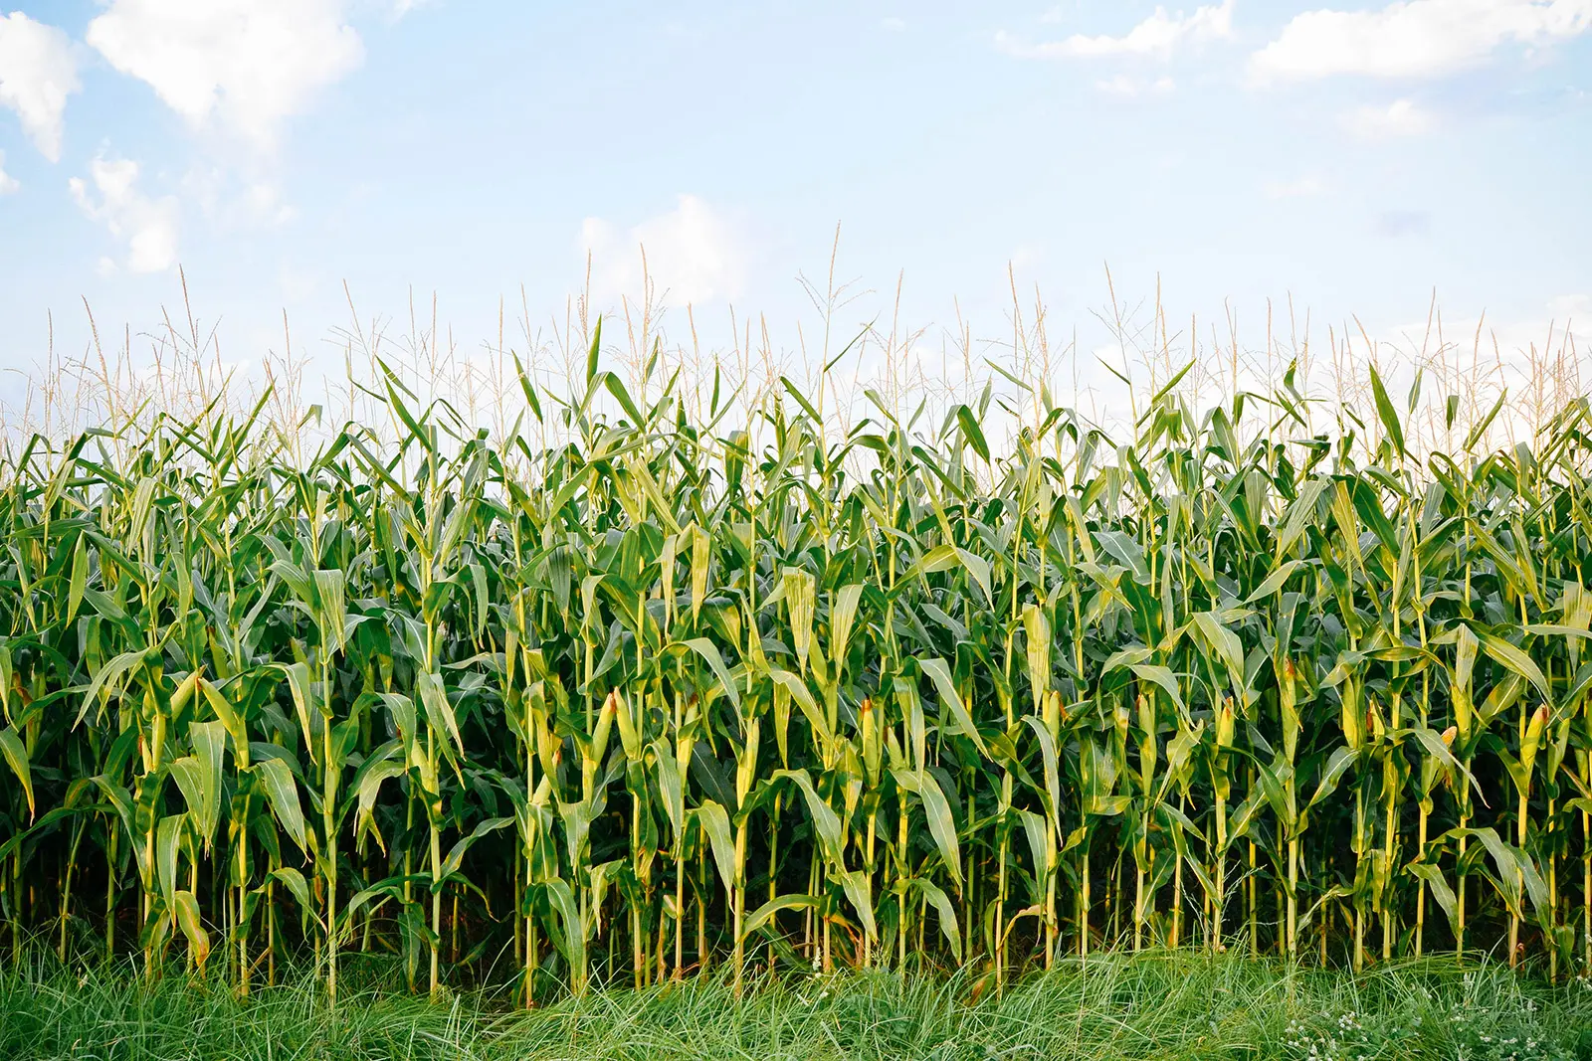
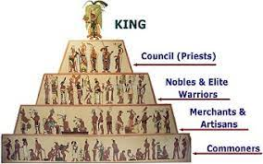
Before we elaborate more on what factors led to the collapse of the Mayan civilization, we must first discuss the characteristics of the Maya civilization. More specifically, we will discuss their social structure and agricultural practices.
Notes:
References:
Image source of Maize: Ly, L. (2021, November). The Surprising Difference Between Corn and Maize. Garden Betty. https://www.gardenbetty.com/corn-vs-maize/
Image source for Maya social hierarchy: Maya Society n.d., digital image, History’s History, accessed March 30, 2023, <http://www.historyshistories.com/maya-society.html>
Maya Society. (n.d.). Retrieved from http://www.historyshistories.com/maya-society.html
Graham, J. (2023, March 07). Annotated Bibliography. Dropbox. https://www.dropbox.com/s/lqleovu77hsa0zd/AnnotatedBibliography.pdf?dl=0

Slide 12
Like many civilizations in Mesoamerica at that time, the Mayans had a monarchy system to hierarchically organize society into six distinct groups: Kings, council members and priests, nobles and elite warriors, merchants and craftsmen, commoners and workers, and lastly, slaves.
Notes:
References:
Image source for Maya social hierarchy: Maya Society n.d., digital image, History’s History, accessed March 30, 2023, <http://www.historyshistories.com/maya-society.html>
Maya Society. (n.d.). Retrieved from http://www.historyshistories.com/maya-society.html
Graham, J. (2023, March 07). Annotated Bibliography. Dropbox. https://www.dropbox.com/s/lqleovu77hsa0zd/AnnotatedBibliography.pdf?dl=0

Slide 13
Although a monarchy system at its core, the Maya civilization had one noble family ruling over each city. The position of king was completely hereditary, meaning the son of a king could be the only individual appointed king. Larger cities often had kings which controlled smaller ones immediately around them. Because of their absolute power, kings were considered sacred ruler who was believed to a descendant of a god. Eventually, the king was replaced if there was evidence that they lost favour with the gods.
Notes:
References:
Image source for Maya social hierarchy: Maya Society n.d., digital image, History’s History, accessed March 30, 2023, <http://www.historyshistories.com/maya-society.html>
Maya Society. (n.d.). Retrieved from http://www.historyshistories.com/maya-society.html
Graham, J. (2023, March 07). Annotated Bibliography. Dropbox. https://www.dropbox.com/s/lqleovu77hsa0zd/AnnotatedBibliography.pdf?dl=0

Slide 14
At the bottom of the hierarchy were the commoners, equivalent to lower- or working-class people of today. Because the Maya civilization depended so heavily on agriculture for food and trade, commoners were farmers for the entirety of the growing season, and builders of cities and sites when not farming. *Continue talk about commoners, and warriors, regardless of social rank, what diet mainly consisted of, and how droughts and unfavourable climate conditions lead to the death of many commoners and farms*
Notes:
References:
Image source for Maya social hierarchy: Maya Society n.d., digital image, History’s History, accessed March 30, 2023, <http://www.historyshistories.com/maya-society.html>
Maya Society. (n.d.). Retrieved from http://www.historyshistories.com/maya-society.html
Graham, J. (2023, March 07). Annotated Bibliography. Dropbox. https://www.dropbox.com/s/lqleovu77hsa0zd/AnnotatedBibliography.pdf?dl=0

Slide 15
Immediately below kings were council members and priests. Because religion was well-grounded in Maya activities, priests were behind only kings in their social rankings, and considered the keepers of knowledge, those who were highly educated in religion, linguistics, mathematics, astronomy, astrology, and history. More importantly, they studied the complex Maya calendar and advised on when to plant crops for optimal harvest. Priests hosted regular religious ceremonies, with offerings or even a sacrifice, to communicate with the gods and interpret the gods’ will.
Notes:
References:
Image source for Maya social hierarchy: Maya Society n.d., digital image, History’s History, accessed March 30, 2023, <http://www.historyshistories.com/maya-society.html>
Maya Society. (n.d.). Retrieved from http://www.historyshistories.com/maya-society.html
Graham, J. (2023, March 07). Annotated Bibliography. Dropbox. https://www.dropbox.com/s/lqleovu77hsa0zd/AnnotatedBibliography.pdf?dl=0

Slide 16
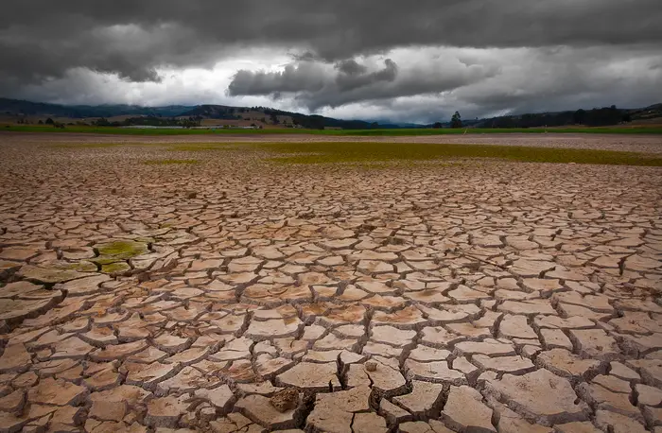
Now that we are finished discussing some prerequisite knowledge of the ancient Maya civilization, our focus will pivot back to The Terminal Classic Period. As mentioned earlier, a multitude of factors contributed to the downfall of the Maya civilization. Our focus will be on the 9th and 10th centuries, as that is when the Maya civilization experienced a significant decline. Our discussion will involve the contributions of military losses, the collapse of trade routes, too-large populations, and the loss of vegetation.
Notes:
References:
Image source: Dry section of desert, digital image, accessed March 23, 2023 <https://www.insider.com/maya-civilization-fall-droughts-climate-change-mexico-2016-6>
Graham, J. (2023, March 07). Annotated Bibliography. Dropbox. https://www.dropbox.com/s/lqleovu77hsa0zd/AnnotatedBibliography.pdf?dl=0

Slide 17
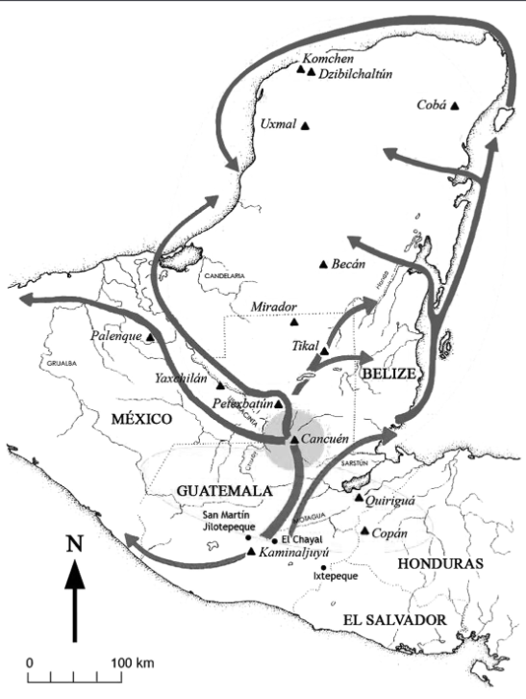
As our first discussion point, we will consider the collapse of trade routes. Building on our earlier discussion about the southern and northern Maya lowlands, archeological evidence in the 20th and 21st centuries uncovered sites of pottery and stone tools in the Maya lowlands, dating back to the Classic Period. Analysis of these tools and sediment revealed trade networks in these areas, where the Maya would exchange exotic goods and obsidian, their main tool material. As seen in the diagram, elaborate trade networks were established over inland water bodies.
Notes:
References:
Zeitlin, R. N. (1984). Archeology and volcanism in Central America. Science, 226, 163+. https://link-gale-com.ezproxy.lakeheadu.ca/apps/doc/A3472821/AONE?u=ocul_lakehead&sid=bookmark- AONE&xid=49347507
Demarest, A. A,. (n.d.). The Collapse of The Classic Maya Kingdoms of the Southwestern Petén: Implications for the End of Classic Maya Civilization. Vanderbilt University. https://www.mesoweb.com/publications/MMS/2_Demarest.pdf
Image source: (2018, Jan 30). Shifting trade routes may have led to Maya decline. Belize Travel Blog. https://belize-travel-blog.chaacreek.com/2012/05/shifting-trade-routes-may-have-led-to-maya-decline/
Graham, J. (2023, March 07). Annotated Bibliography. Dropbox. https://www.dropbox.com/s/lqleovu77hsa0zd/AnnotatedBibliography.pdf?dl=0

Slide 18
Because the main material resource used by the Maya for tools and power procurement by Maya elites, researchers at the University of Illinois traced the movement of obsidian through sediment analysis. They discovered the trade of obsidian and other materials declined as trade routes were shifted from inland river networks to coastal networks. As inland trade centers decreased, the reliance on coastal trade networks increased, depriving many key Maya inland cities and sites of needed resources.
Notes:
References:
Zeitlin, R. N. (1984). Archeology and volcanism in Central America. Science, 226, 163+. https://link-gale-com.ezproxy.lakeheadu.ca/apps/doc/A3472821/AONE?u=ocul_lakehead&sid=bookmark- AONE&xid=49347507
Demarest, A. A,. (n.d.). The Collapse of The Classic Maya Kingdoms of the Southwestern Petén: Implications for the End of Classic Maya Civilization. Vanderbilt University. https://www.mesoweb.com/publications/MMS/2_Demarest.pdf
(2018, Jan 30). Shifting trade routes may have led to Maya decline. Belize Travel Blog. https://belize-travel-blog.chaacreek.com/2012/05/shifting-trade-routes-may-have-led-to-maya-decline/
Graham, J. (2023, March 07). Annotated Bibliography. Dropbox. https://www.dropbox.com/s/lqleovu77hsa0zd/AnnotatedBibliography.pdf?dl=0

Slide 19
When augmented by unfavourable climate conditions causing a linear decrease in both precipitation and available natural resources, inland cities and sites were starved of the materials they needed. Maya rulers and priests used obsidian to procure power and respect, often establishing relationships by sending gifts of obsidian and believed by many to
Notes:
References:
Zeitlin, R. N. (1984). Archeology and volcanism in Central America. Science, 226, 163+. https://link-gale-com.ezproxy.lakeheadu.ca/apps/doc/A3472821/AONE?u=ocul_lakehead&sid=bookmark- AONE&xid=49347507
Demarest, A. A,. (n.d.). The Collapse of The Classic Maya Kingdoms of the Southwestern Petén: Implications for the End of Classic Maya Civilization. Vanderbilt University. https://www.mesoweb.com/publications/MMS/2_Demarest.pdf
(2018, Jan 30). Shifting trade routes may have led to Maya decline. Belize Travel Blog. https://belize-travel-blog.chaacreek.com/2012/05/shifting-trade-routes-may-have-led-to-maya-decline/
Graham, J. (2023, March 07). Annotated Bibliography. Dropbox. https://www.dropbox.com/s/lqleovu77hsa0zd/AnnotatedBibliography.pdf?dl=0

Slide 20
Because the main material resource used by the Maya for tools and power procurement by Maya elites, researchers at the University of Illinois traced the movement of obsidian through Mesoamerica during the 8th, 9th, and 10th centuries. They discovered the trade of obsidian and other materials declined as trade routes were shifted from inland river networks to coastal networks. As inland trade centers decreased, the reliance on coastal trade networks increased, depriving many key Maya inland cities and sites of resources.
Notes:
References:
Zeitlin, R. N. (1984). Archeology and volcanism in Central America. Science, 226, 163+. https://link-gale-com.ezproxy.lakeheadu.ca/apps/doc/A3472821/AONE?u=ocul_lakehead&sid=bookmark- AONE&xid=49347507
Demarest, A. A,. (n.d.). The Collapse of The Classic Maya Kingdoms of the Southwestern Petén: Implications for the End of Classic Maya Civilization. Vanderbilt University. https://www.mesoweb.com/publications/MMS/2_Demarest.pdf
(2018, Jan 30). Shifting trade routes may have led to Maya decline. Belize Travel Blog. https://belize-travel-blog.chaacreek.com/2012/05/shifting-trade-routes-may-have-led-to-maya-decline/
Graham, J. (2023, March 07). Annotated Bibliography. Dropbox. https://www.dropbox.com/s/lqleovu77hsa0zd/AnnotatedBibliography.pdf?dl=0

Slide 21
Continuing our discussion, we will dissect how warfare was a significant contributing factor. By the 8th century, the Maya developed a highly sophisticated civilization with advanced systems of agriculture, writing, art, and literature. Mostly, these systems were rooted in powerful city-states such as Tikal (Cyan), Calakmul (Black), and Palenque (Purple), all of which competed for control of resources and territory. However, archeological evidence suggests conflicts such as the above may have a deeper meaning.
Notes:
References:
Image source for Mesoamerica map: Classical Mayan Period 2016, digital image, Human History In Brief, accessed March 22, 2023, <http://www.humanhistoryinbrief.net/2016/11/>
Graham, J. (2023, March 07). Annotated Bibliography. Dropbox. https://www.dropbox.com/s/lqleovu77hsa0zd/AnnotatedBibliography.pdf?dl=0

Slide 22
In late 20th-century and modern-day 21st-century studies, new archeological evidence has emerged suggesting that both internal and external military losses, revealed by evidence of mass killings, defensive structures, and burned buildings, suggest repeated military actions decimated the surrounding area. Additionally, studies have found clues of the Maya monarchy system breaking down, causing political instability and infighting as powerful rulers, nobles, and priests were disposed of.
Notes:
References:
Image source for Mesoamerica map: Classical Mayan Period 2016, digital image, Human History In Brief, accessed March 22, 2023, <http://www.humanhistoryinbrief.net/2016/11/>
Graham, J. (2023, March 07). Annotated Bibliography. Dropbox. https://www.dropbox.com/s/lqleovu77hsa0zd/AnnotatedBibliography.pdf?dl=0

Slide 23
Archeological excavations conducted by researchers at the site of Dos Pilas (Red), located in modern-day Guatemala (Purple), revealed a series of hidden defense structures, including walls, towers, and moats, in various states of decay. Thus, the researchers proposed that the site was under attack by some foreign invaders. In addition, further evidence of mass killings and other acts of violence suggests the site was eventually overrun by enemy forces.
Notes:
References:
Image source for Mesoamerica map: Classical Mayan Period 2016, digital image, Human History In Brief, accessed March 22, 2023, <http://www.humanhistoryinbrief.net/2016/11/>
Graham, J. (2023, March 07). Annotated Bibliography. Dropbox. https://www.dropbox.com/s/lqleovu77hsa0zd/AnnotatedBibliography.pdf?dl=0

Slide 24
At other Maya sites, including Tikal and Copan, similar archeological data has been compiled. At Tikal specifically, researchers found evidence of burned buildings and mass killings, facing the same situation as Dos Pilas. Copan has much more sinister data, however, with human remains found in a mass grave site. As these cities and sites were attacked and occupied by foreign invaders, many were forced to flee or were killed, leading to the mass abandonment of many inland and coastal sites and cities.
Notes:
References:
Image source for Mesoamerica map: Classical Mayan Period 2016, digital image, Human History In Brief, accessed March 22, 2023, <http://www.humanhistoryinbrief.net/2016/11/>
Graham, J. (2023, March 07). Annotated Bibliography. Dropbox. https://www.dropbox.com/s/lqleovu77hsa0zd/AnnotatedBibliography.pdf?dl=0

Slide 25
As our last discussion point, we will switch our focus to how poor climate conditions, particularly harsh droughts in Mesoamerica in the 9th and 10th centuries, were the most significant factor in the collapse of the Maya civilization. Shown here on the slide is a hint as to what was particularly devastating for the Maya civilization. However, we must first discuss the agricultural practices of the Maya to fully appreciate the upcoming slides.
Notes:
References:
Image source of Maize: Ly, L. (2021, November). The Surprising Difference Between Corn and Maize. Garden Betty. https://www.gardenbetty.com/corn-vs-maize/
Graham, J. (2023, March 07). Annotated Bibliography. Dropbox. https://www.dropbox.com/s/lqleovu77hsa0zd/AnnotatedBibliography.pdf?dl=0

Slide 26
Maya agriculture is traditionally highly adapted to the seasonal rhythms of regional precipitation, which means the Maya civilization depended on stable and predictable amounts of precipitation to have successful crop harvests.
Notes:
References:
Image source of Maize: Ly, L. (2021, November). The Surprising Difference Between Corn and Maize. Garden Betty. https://www.gardenbetty.com/corn-vs-maize/
Graham, J. (2023, March 07). Annotated Bibliography. Dropbox. https://www.dropbox.com/s/lqleovu77hsa0zd/AnnotatedBibliography.pdf?dl=0

Slide 27
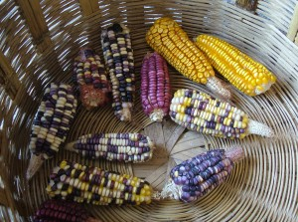
Typically, the Maya lowlands circled in red were the locations where agriculture took place for many reasons: The soil was rich and fertile because of the dense vegetation and favourable climate; lakes and water sources were plentiful; wetlands were numerous and animals were plentiful. In the Maya lowlands, the main crop grown was Maize. Maize is a corn crop on which as much as 80% of the Mayans’ diet consisted.
Notes:
References:
Image source for coloured Maize: Mesoamerican Cultures and their Histories 2015, digital image, accessed March 30, 2023, <https://blogs.uoregon.edu/mesoinstitute/about/curriculum-unit-development/stem/ethnobotany/maizecorn/>
Image source for Mesoamerica map: Classical Mayan Period 2016, digital image, Human History In Brief, accessed March 22, 2023, <http://www.humanhistoryinbrief.net/2016/11/>
Graham, J. (2023, March 07). Annotated Bibliography. Dropbox. https://www.dropbox.com/s/lqleovu77hsa0zd/AnnotatedBibliography.pdf?dl=0

Slide 28
In contrast to the Maya lowlands, regions ranging from 40 to 300 metres in elevation are referred to as the elevated interior region (EIR), encompassing the mountainous regions of the Maya highlands. These elevated regions were not used for agriculture or other significant cities and sites because of spare lakes and water sources, thin and infertile soil, seasonally-dependent surface drainage, and little-to-no groundwater combined with a low water table level.
Notes:
References:
Graham, J. (2023, March 07). Annotated Bibliography. Dropbox. https://www.dropbox.com/s/lqleovu77hsa0zd/AnnotatedBibliography.pdf?dl=0

Slide 29
The Elevated Interior Region (EIR), known as the Maya highlands, was the center for all cultural development, religious practices, and great architectural structures. Maya royalty and elites had structures and palaces built here for religious purposes such as sacrificial burials as offerings to the gods, and for resource distribution purposes in the form of a trade route, where obsidian, jade, and other precious metals and commodities would be exchanged.
Notes:
References:
Graham, J. (2023, March 07). Annotated Bibliography. Dropbox. https://www.dropbox.com/s/lqleovu77hsa0zd/AnnotatedBibliography.pdf?dl=0

Slide 30
Although flourishing, the lowland Maya was subject to many natural disasters, most notably frequent hurricane strikes and forest fires. These natural disasters decimated large areas of the dense forest and vegetation covering the Maya lowlands, killed animals, and contaminated both stagnant and flowing water sources.
Notes:
References:
Graham, J. (2023, March 07). Annotated Bibliography. Dropbox. https://www.dropbox.com/s/lqleovu77hsa0zd/AnnotatedBibliography.pdf?dl=0

Slide 31
Sediment analysis from the archaeological evidence of excavations of various coasts revealed drastic climate change occurring in the latter half of the first millennium A.D., particularly after 800 A.D. Hastened by Maya’s clearcutting techniques and alteration of wetlands and forests, climate conditions gradually worsened. Immediately before this, however, from 500 A.D. to 700 A.D., there was a population boom which exceeded the carrying capacity of the environment.
Notes:
References:
Graham, J. (2023, March 07). Annotated Bibliography. Dropbox. https://www.dropbox.com/s/lqleovu77hsa0zd/AnnotatedBibliography.pdf?dl=0

Slide 32
Gradually worsening climate conditions resulted in very inconsistent seasonal precipitation. Further sediment analysis showed a century-long decline in rainfall, intermixed with intense multiple-year droughts around 810, 860, and 910 A.D. These major dry events were particularly deadly for the corn crop Maize, which was very sensitive to dry soil, and which made up at least 80% of the Maya diet.
Notes:
References:
Graham, J. (2023, March 07). Annotated Bibliography. Dropbox. https://www.dropbox.com/s/lqleovu77hsa0zd/AnnotatedBibliography.pdf?dl=0

Slide 33
Previously, we mentioned how Maya elites, specifically priests, were individuals who were praised for acting as a mediator between Earth and the Heavens. Because the Maya civilization had religion as a fundamental societal construct, Maya elites believed in offering a human sacrifice to Heaven’s gods to keep favourable climate conditions. The basis of specific practices performed was based on widely held Maya beliefs about life, death, supernatural beings, and cosmology.
Notes:
References:
Graham, J. (2023, March 07). Annotated Bibliography. Dropbox. https://www.dropbox.com/s/lqleovu77hsa0zd/AnnotatedBibliography.pdf?dl=0

Slide 34
Because of the unfavourable climate conditions and gradually waning natural resource base, the Maya citizens began losing faith in the Maya elites, specifically, the priests. The Maya believed their situation was because they had fallen out of favour with the gods and were being punished. Because the Maya leadership controlled the resources, they distributed less amongst the Maya citizens because of a small resource base.
Notes:
References:
Graham, J. (2023, March 07). Annotated Bibliography. Dropbox. https://www.dropbox.com/s/lqleovu77hsa0zd/AnnotatedBibliography.pdf?dl=0

Slide 35
As a result, conflicts between the Maya elites and citizens weakened the Maya, resulting in the subsequent fall of the Classic Maya kings in the late 9th century A.D., when in Mesoamerica, kingship was discredited and crumbled, shown as a scapegoat model which is bound to always fail.
Notes:
References:
Graham, J. (2023, March 07). Annotated Bibliography. Dropbox. https://www.dropbox.com/s/lqleovu77hsa0zd/AnnotatedBibliography.pdf?dl=0
Hutson, S. R. (2017). History, politics and meaning among the Classic Period Maya of the southern lowlands. Antiquity, 91(356), 533+. https://link-gale com.ezproxy.lakeheadu.ca/apps/doc/A494099403/AONE?u=ocul_lakehead&sid=bookmark-AONE&xid=9d4d42b8

Slide 36
For our final discussion point, we will consider how urban city development in the Northern and Southern Maya lowlands accelerated droughts in Mesoamerica. Recent 21st-century studies have shown that specific Maya urban centers, such as Tikal, had as many as 80,000 people at the tail-end of the Classic Period around 750 A.D. Although a major discovery of urban development in the Maya lowlands was the capacity to sustain large populations through long, dry seasons of little rainfall, the natural environment did not hold such a capacity.
Notes:
References:
Graham, J. (2023, March 07). Annotated Bibliography. Dropbox. https://www.dropbox.com/s/lqleovu77hsa0zd/AnnotatedBibliography.pdf?dl=0
Adams, R. E. W. (1991). Nucleation of population and water storage among the ancient Maya. Science, 251(4994), 632. https://link-gale-com.ezproxy.lakeheadu.ca/apps/doc/A10425615/AONE?u=ocul_lakehead&sid=bookmar k-AONE&xid=8f0f93b1

Slide 37
The Maya constructed large water reservoirs as integral parts of society to have sufficient water for both agriculture and to sustain a population. Because a significant source of water was needed for any settlement, the Maya had to create several storage zones to support populations. These reservoirs brought with them elite-class individuals who sought to use water for social control.
Notes:
References:
Graham, J. (2023, March 07). Annotated Bibliography. Dropbox. https://www.dropbox.com/s/lqleovu77hsa0zd/AnnotatedBibliography.pdf?dl=0
Adams, R. E. W. (1991). Nucleation of population and water storage among the ancient Maya. Science, 251(4994), 632. https://link-gale-com.ezproxy.lakeheadu.ca/apps/doc/A10425615/AONE?u=ocul_lakehead&sid=bookmar k-AONE&xid=8f0f93b1

Slide 38
The Classic Period saw the abandonment of centers and cities in favour of communities with sufficient water resources. Unfortunately, this meant having to intensify the acquisition of food and other natural resources, using up the water resources faster than they could be replenished. Interestingly, despite the water crisis which plagued the Maya civilization during the 9th and 10th centuries, swamps and shallow lakes near cities were modified or drained to make way for intensive food production.
Notes:
References:
Graham, J. (2023, March 07). Annotated Bibliography. Dropbox. https://www.dropbox.com/s/lqleovu77hsa0zd/AnnotatedBibliography.pdf?dl=0
Adams, R. E. W. (1991). Nucleation of population and water storage among the ancient Maya. Science, 251(4994), 632. https://link-gale-com.ezproxy.lakeheadu.ca/apps/doc/A10425615/AONE?u=ocul_lakehead&sid=bookmar k-AONE&xid=8f0f93b1

Slide 39
Early lowland Maya cities such as Mirador and Nakbe were abandoned exclusively because of extremely low water levels. However, some cities such as Rio Azul and Siebal were abandoned because of political and military disarray, particularly when the mismanagement of resources by Maya elites and the lack of environmental preservation led to poor climate conditions.
Notes:
References:
Graham, J. (2023, March 07). Annotated Bibliography. Dropbox. https://www.dropbox.com/s/lqleovu77hsa0zd/AnnotatedBibliography.pdf?dl=0
Adams, R. E. W. (1991). Nucleation of population and water storage among the ancient Maya. Science, 251(4994), 632. https://link-gale-com.ezproxy.lakeheadu.ca/apps/doc/A10425615/AONE?u=ocul_lakehead&sid=bookmar k-AONE&xid=8f0f93b1

Slide 40
In conclusion, the Maya in Mesoamerica inflicted onto themselves long periods of extreme droughts and poor climate for many reasons, ranging from the short-sightedness of the Maya rulers to the Maya’ increasing reliance on urban cities and centers that could not sustain large populations. Internal conflicts weakened the Maya civilization enough to be devastated by external invasions, and the breakdown of trading networks and subsequent abandonment of inland cities for larger urban cities led to the beginning of the end.
Notes:
References:
Graham, J. (2023, March 07). Annotated Bibliography. Dropbox. https://www.dropbox.com/s/lqleovu77hsa0zd/AnnotatedBibliography.pdf?dl=0

